Slide 1
Evaluating your Project
Community Mental Health & Wellbeing Fund 2023

Slide 2
Session Overview
6 Month Evaluation Form
End of Year Evaluation
Evaluating your project- are we making a difference?
Some examples

Slide 3
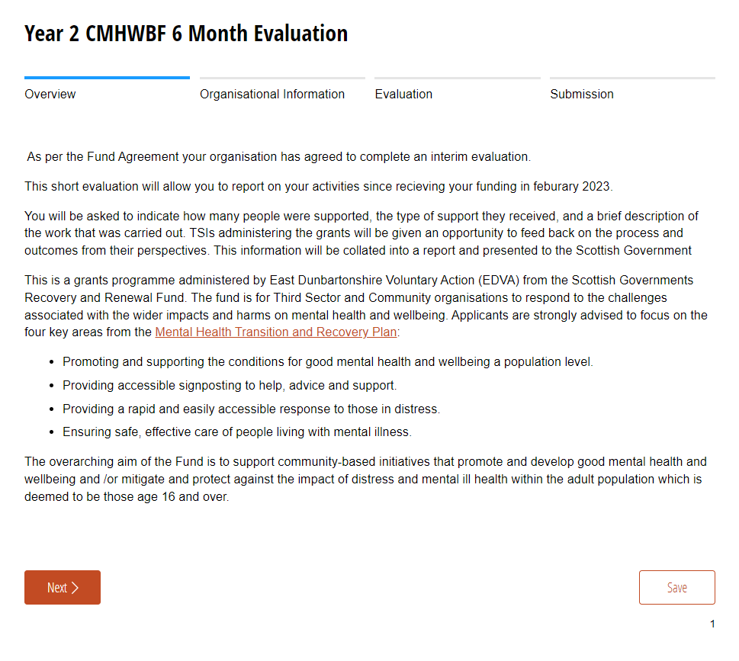

Slide 4
3. The Project
a) Please provide a brief description of the project for which you received funding*
b) Who has benefited from your project? Please give example of demographic and local area.*
c) Estimated number of people who have been supported?*
d) Please provide a brief update on progress to date. *
e) How are you measuring outcomes?*
*(required)

Slide 5
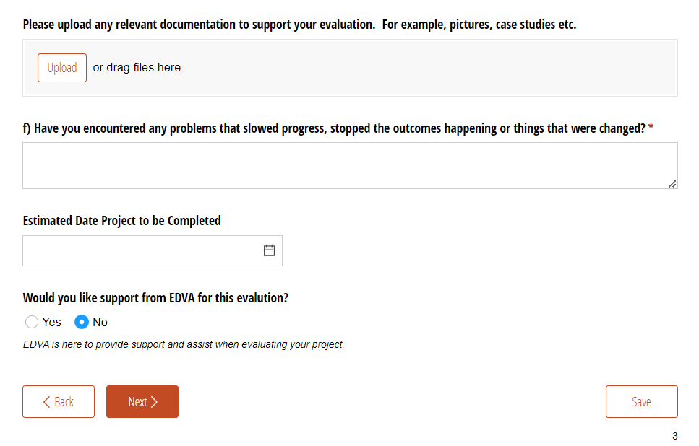

Slide 6
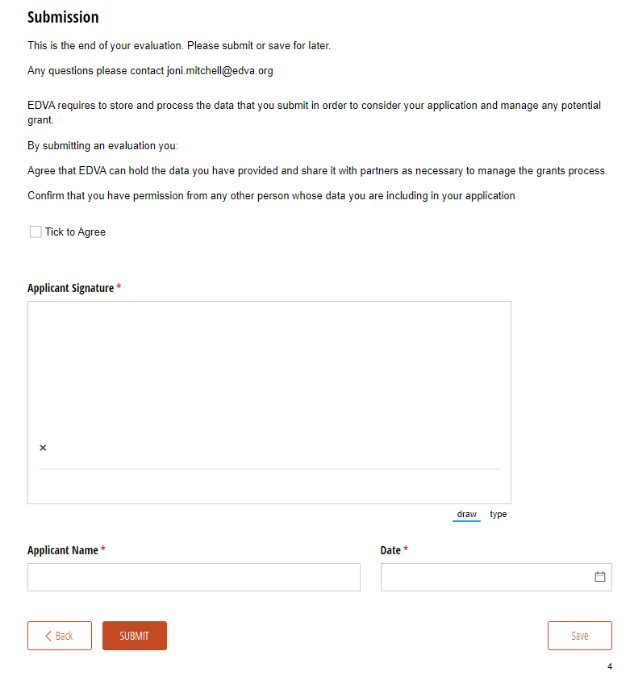

Slide 7
End of year evaluation
We will be looking for…
Overview of the activities
Number of people supported
What difference has the project made?
Evidence of how you have measured outcomes
Learning experiences- what went well & what would you change?
Will the project continue after this funding year?

Slide 8
Roadmap – start with why
1
2
3
4
Our Aims
Why?
What do we do?
What difference does this make?
How will we know?

Slide 9
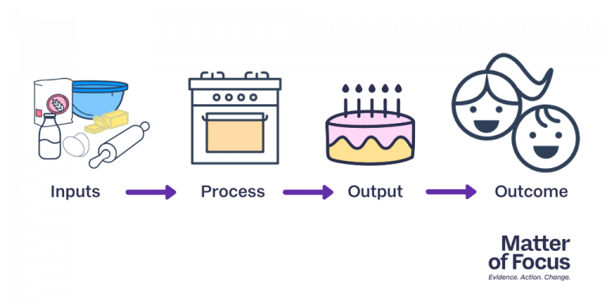

Slide 10
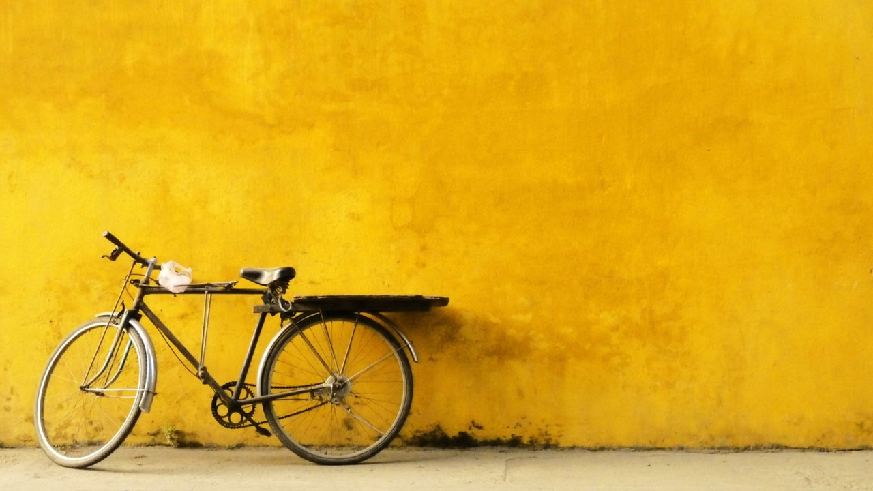
Knowing your outcomes
Input
Activity/Output
Outcome
Bikes, tools, venue, people, skills etc
12 Bike Repair Workshops
New Weekly Cycling Group
Cycling Routes Forum
Community Engagement
Increased Confidence
Improved Fitness
New Friendships
Reduced Isolation
Increased Skills

Slide 11
Evaluation cycle
Defining Outcomes
Setting Indicators
Collecting Evidence
Analysing & Reporting
Acting on this

Slide 12
Collecting Evidence
Feedback Forms
Interviews
Discussion
Surveys
Focus Groups
Self Assessments
Stories
Sticky wall
Evaluation
Drawing
Staff Observations
Tactile Objects
Creative Writing
Reflective
Creative
Diary
Video & Photo’s
Social Media

Slide 13
Example one – scale or wheel
I use my bike
Not at All
A Lot
I feel confident cycling safely
Not at All
A Lot
I know local Cycle Routes
Not at All
A Lot
I am happy with my fitness
Not at All
A Lot
I can . . .
Change seat height
Replace a chain
Repair a puncture
Find route info online

Slide 14
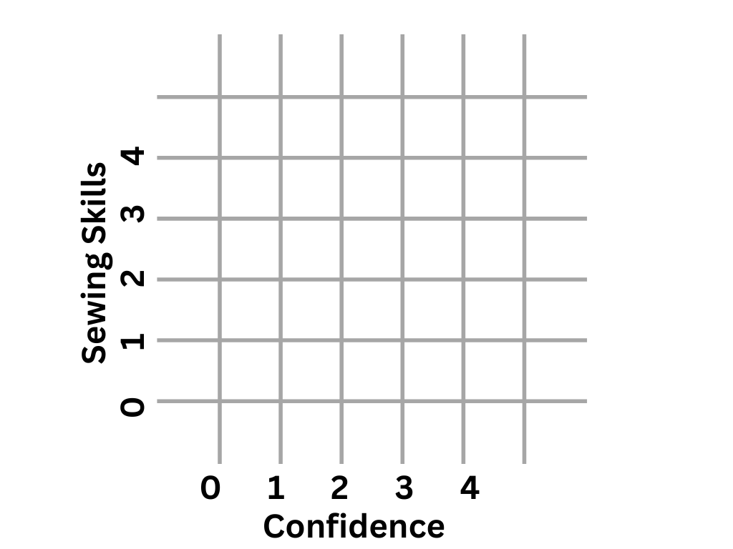
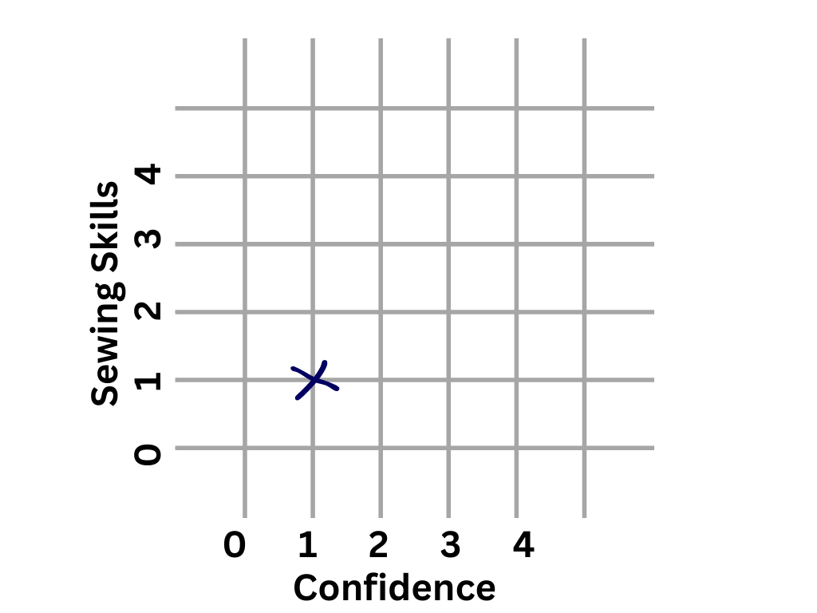
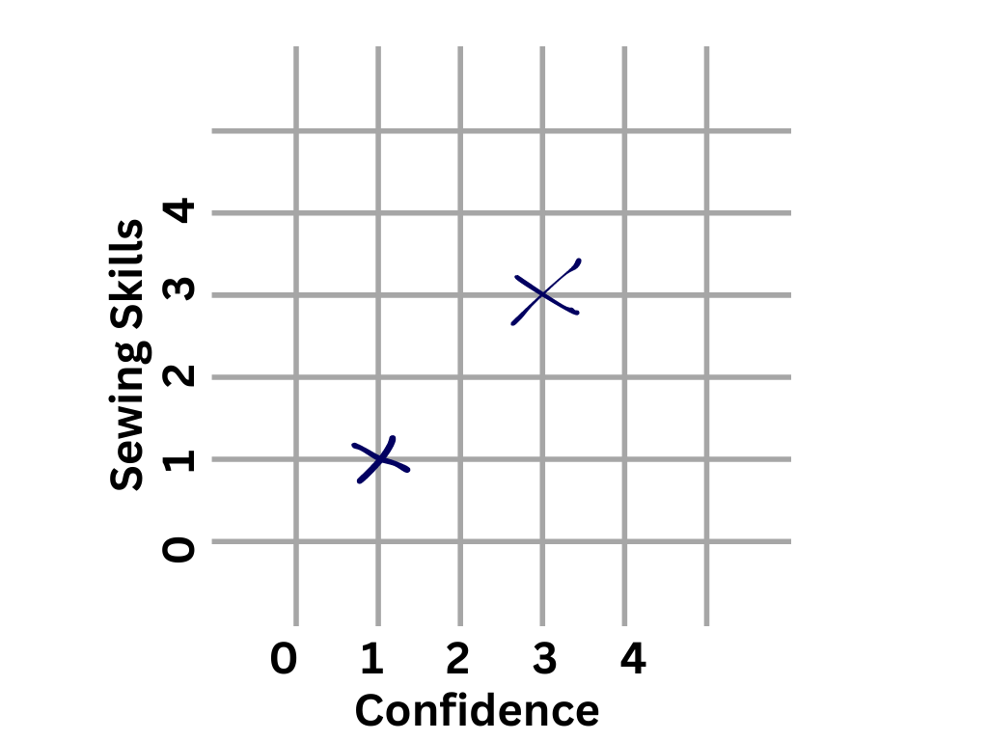
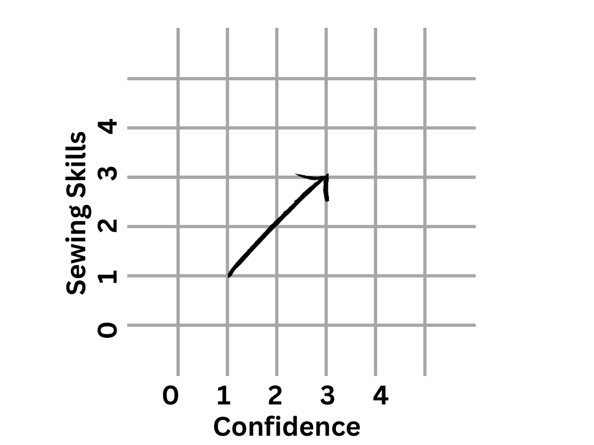

Slide 15
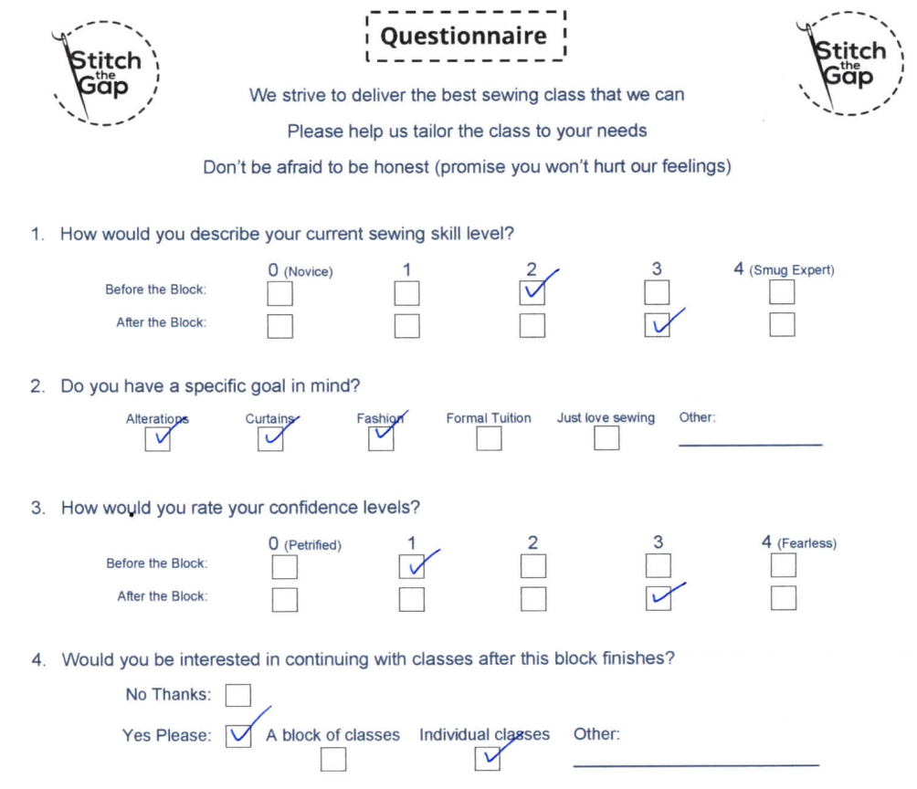

Slide 16
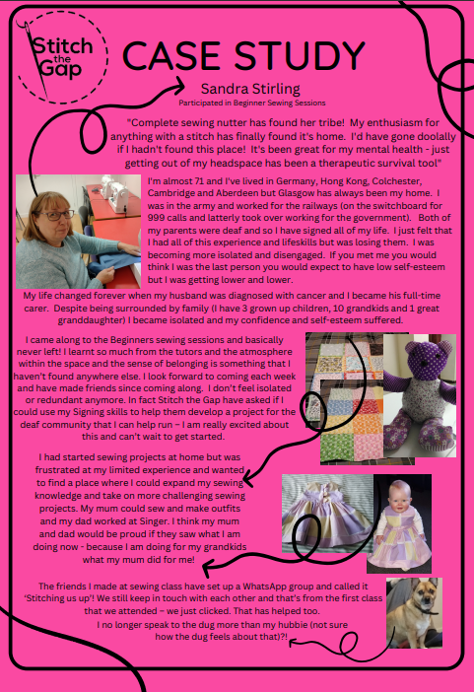
Example two Case Studies

Slide 17
Example three – Sticky Wall
Have you learnt anything from being part of this?
Is there anything you now do differently?
What difference does this make?

Slide 18
Example four Catching Casual Moments
During a home visit from the Advocacy worker and student they commented on I’s birthday cards. She replied “They are from all of my A Bite & A Blether friends.”
V called to apologies for not attending the previous day, informed not to worry that it wasn’t an issue, put at ease. She went on to thank me for everything I do for the group and explained that the last speaker from the library was very informative and that she discovered that she could still access the loan of books

Slide 19
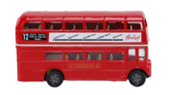
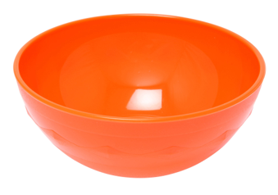
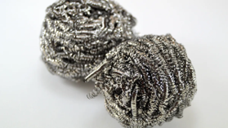
Example FIVE – tactile feedback
Using objects and textures to represent how participants feel about one or more topics
How do you feel about going on the bus?
How do you feel about going to the shop?

Slide 20
Example SIX – SIMPLE feedback form
Something I liked
Something I learnt or was inspired by
Is there anything which could be improved?
Ideas for next time

Slide 21
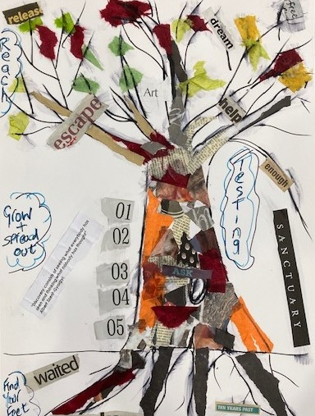
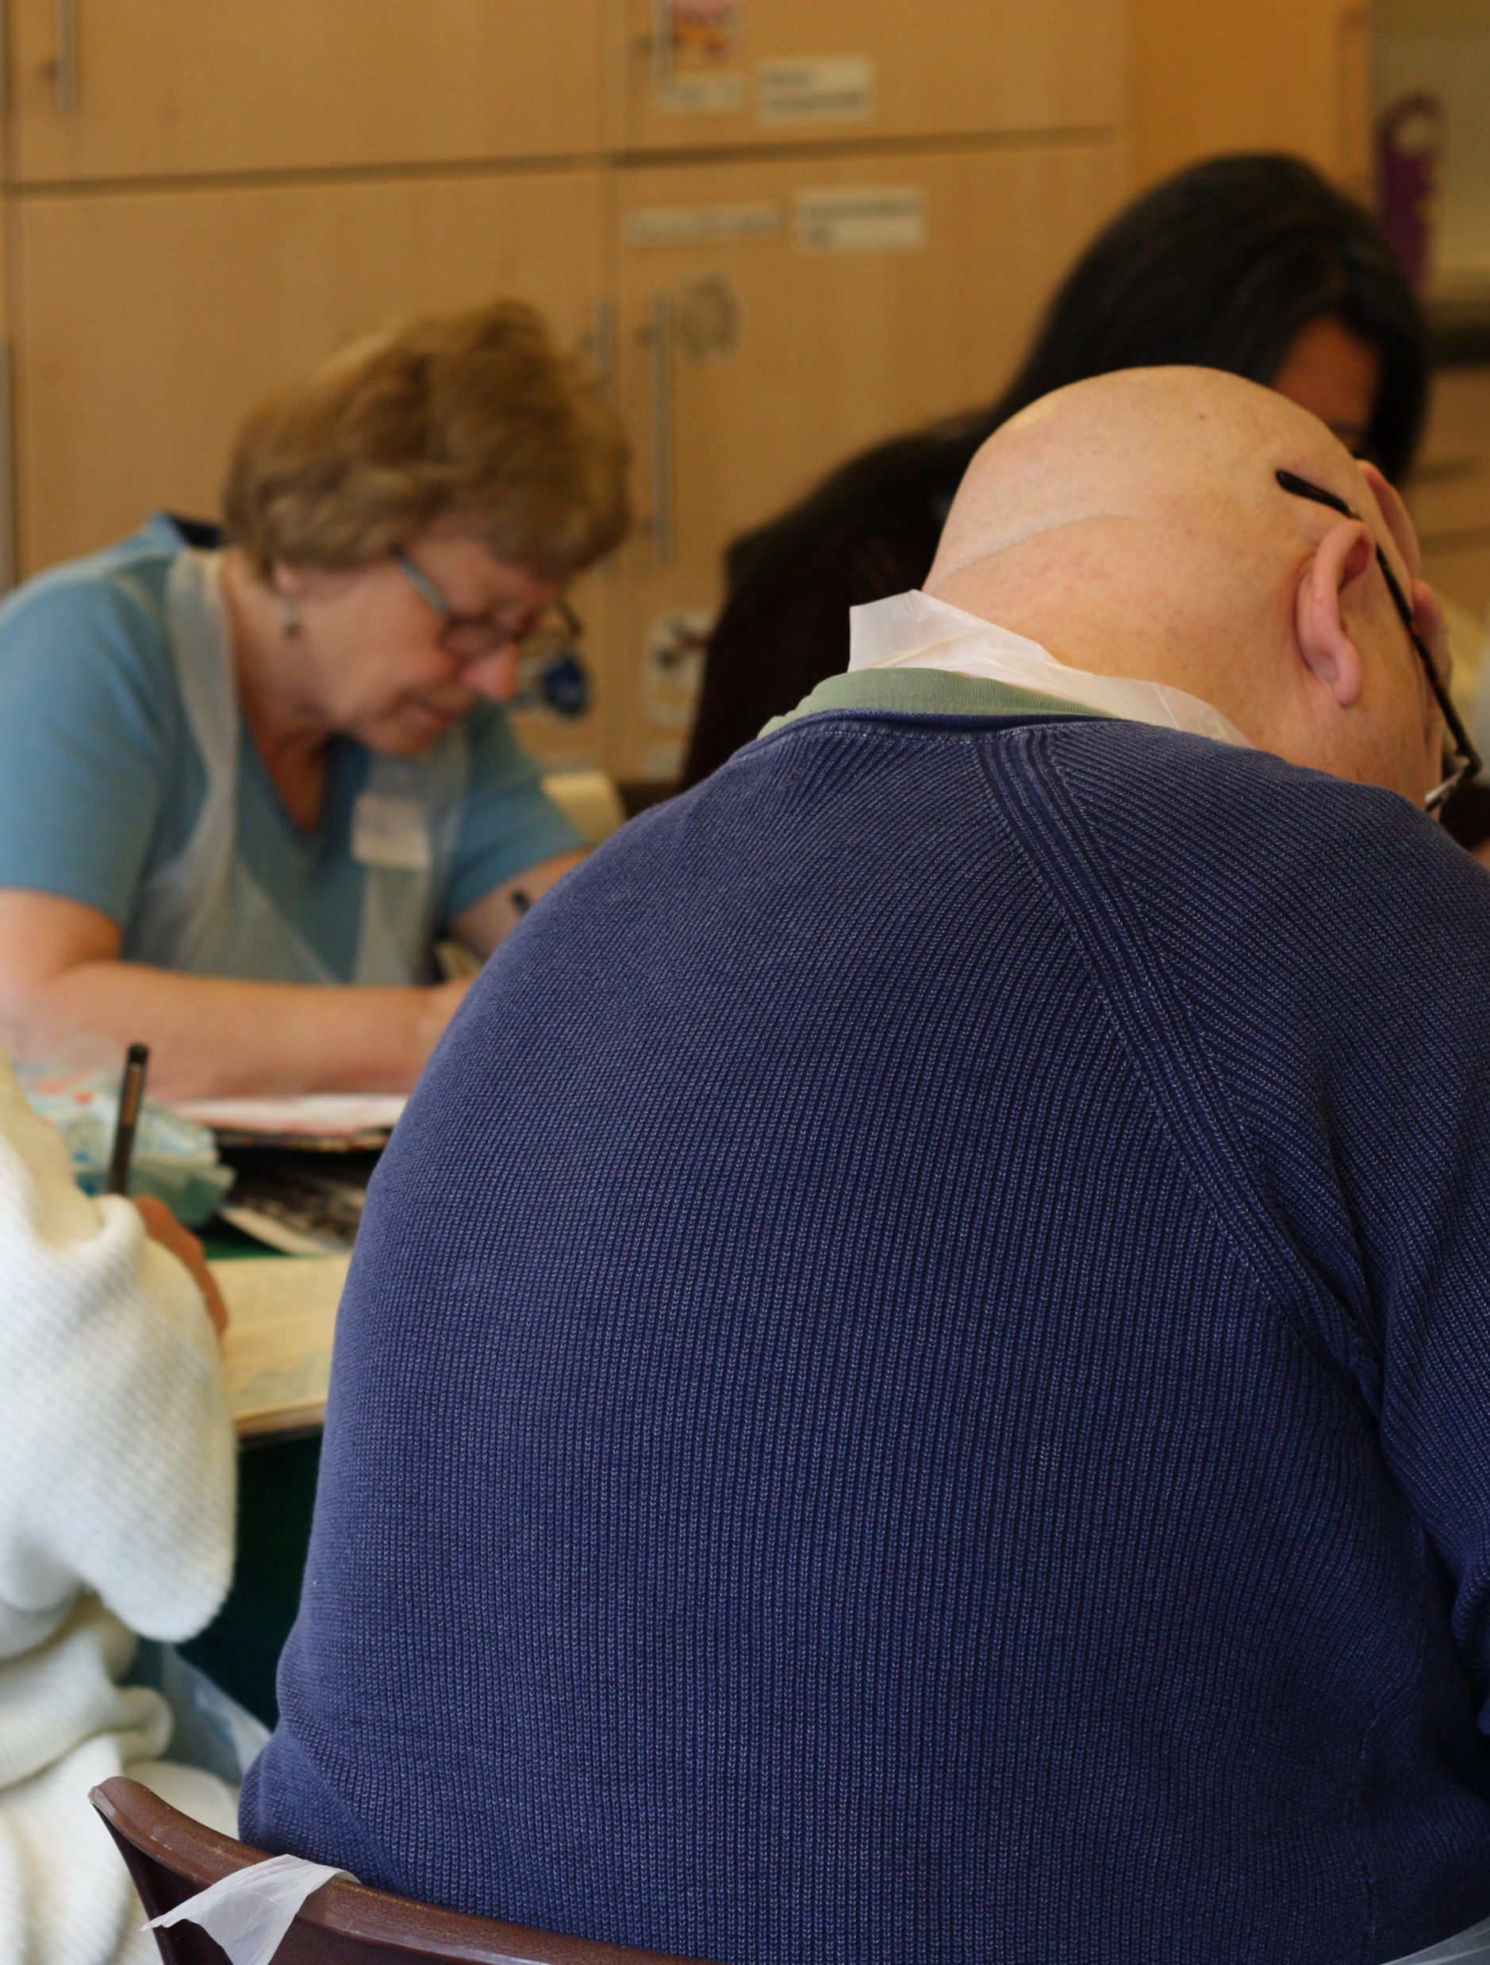
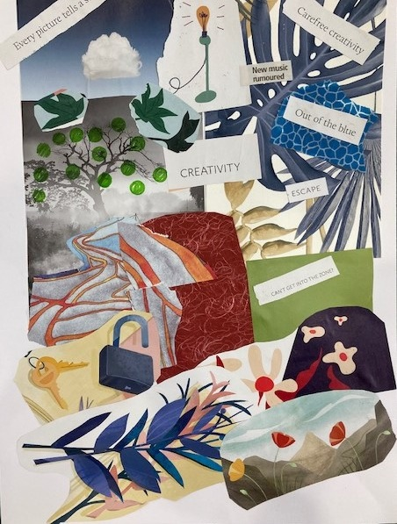
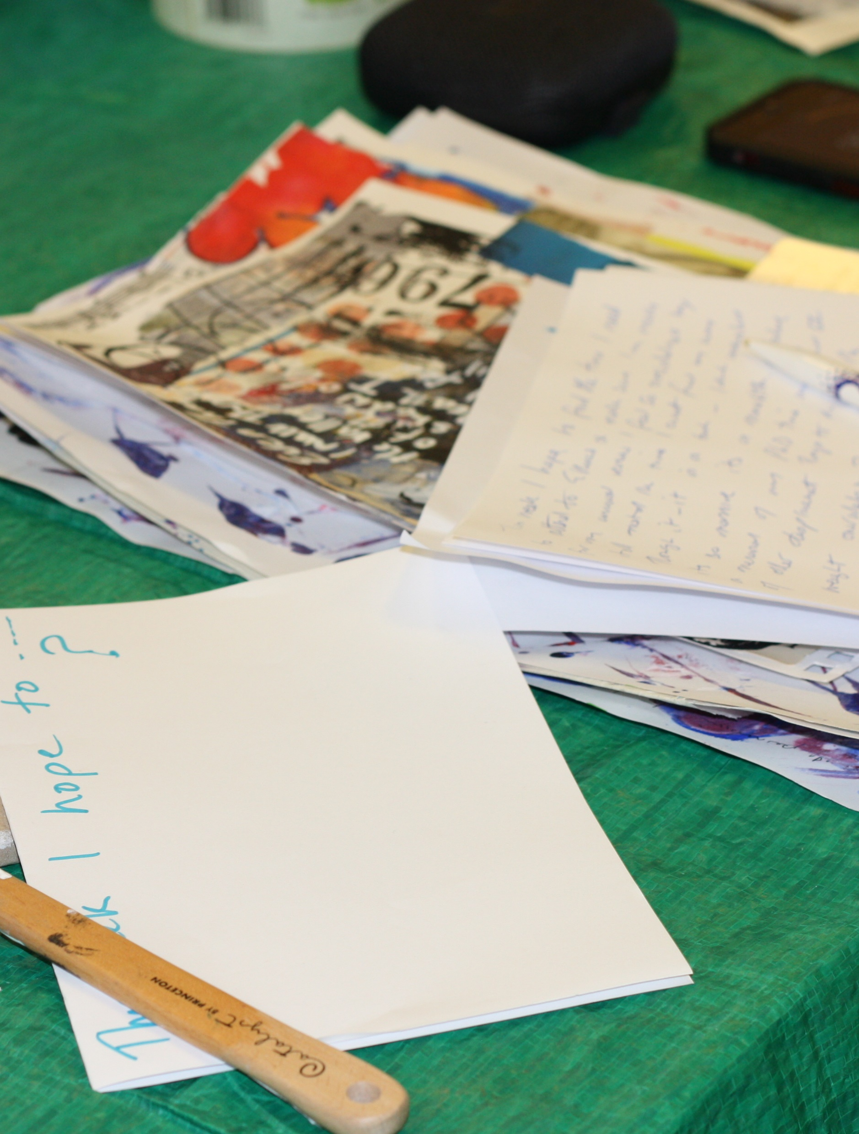
PHOTO’S & VIDEO’S

Slide 22
If you need further support do let us know
Further info and resources
evaluationsupportscotland.org.uk

